Slide 1


Sentiment Analysis
S2_Group2_Project 5

Slide 2

Agenda
Data Overview
Restaurant Reviews
Liked Proposition
Tweets Review
EDA
Text Processing
Cleaning
Pre-Processing
Feature Extraction
ML Models
Naïve Bayes Model
KNN Model
SVM Model
Decision Tree Model
Random Forest Model
Take Aways
Performance
Up Next

Slide 3
Restaurant Reviews
Two Columns : Review and Liked
Preprocessing
Convert in lower case
Remove Punctuation, numbers, and STOPWORDS
Tokenize, perform Stemming
Create Corpus – Bag of Words Model
Highest Frequency of 1190 is for word “ZERO “
Balanced Data (1000 Records) 50% Liked

Slide 4
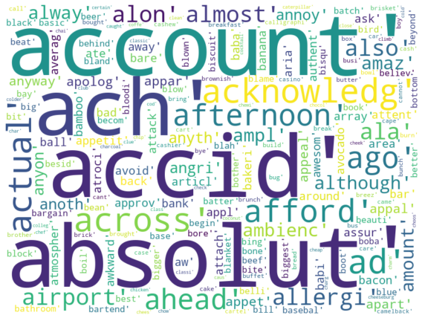
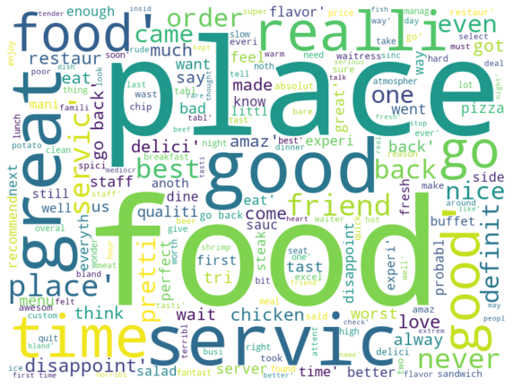
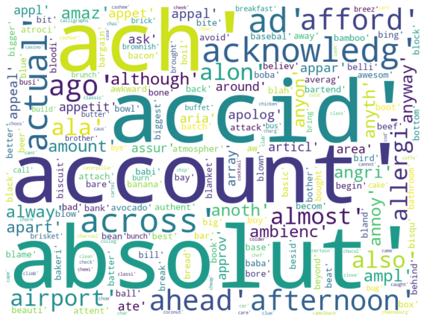
Word Cloud Made of Tokens From REVIEWS
From Corpus
From Tokenizer's Limited Feature Names
From Tokenizer’s all Feature Names

Slide 5
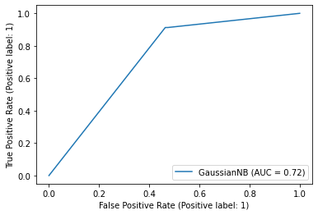
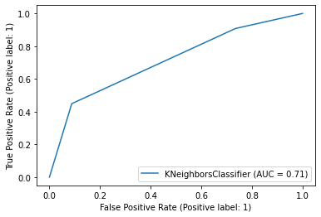
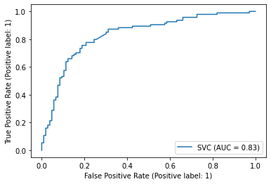
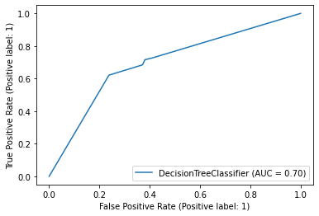
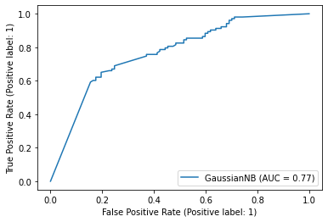
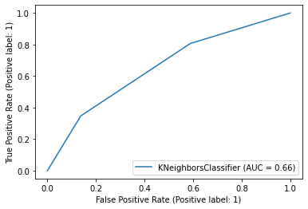
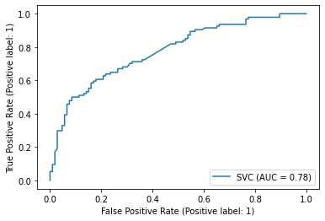
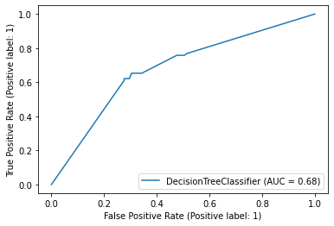
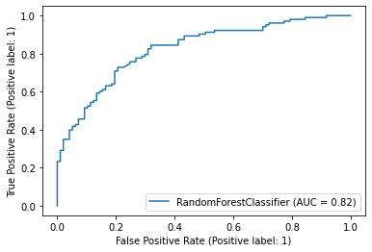
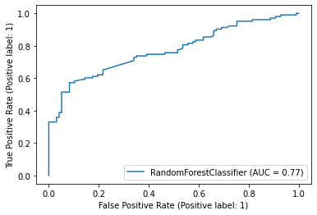
Machine Leaning Models ROC_AUC Curve Performance
Naïve Bayes Model KNN SVC Decision Tree
Simple Bag of Words
TF – IDF
Random Forest
ROC curve area decreased for every model after TF-IDF except the Naïve Bayes Model
Simple Bag of Words
SVM and Random Forest model have the very close and have the highest score, they also had similar decrease after TF-IDF
TF – IDF

Slide 6
Machine Leaning Models Performance
Random Forest best with TF-IDF Accuracy 74% ROC_AUC 74%
SVM best with simple BOW Accuracy 77% ROC_AUC 74%
Performance of all models decreased from simple BOW to TF-IDF except Random Forest

Slide 7
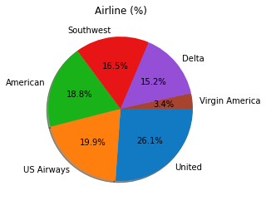
Tweets Sentiments: 15 Columns 14640 Records
United airlines had maximum tweets

Slide 8
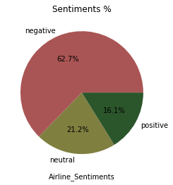
Tweets
62.7% of the tweets are negative tweets and the confidence is 93%

Slide 9
Customer Service is among the highest reasons for negative tweets with high confidence

Slide 10
Tweets
Preprocessing
7 Columns have Missing Data : Extract 2 Relevant columns, text and Sentiment
Remove neutral sentiments : 11541 Records remaining
Remove Punctuation, numbers, and STOPWORDSs
Tokenize, perform Stemming
Create Corpus – Bag of Words Model
Highest Frequency of 2499 is for word “Zone “

Slide 11
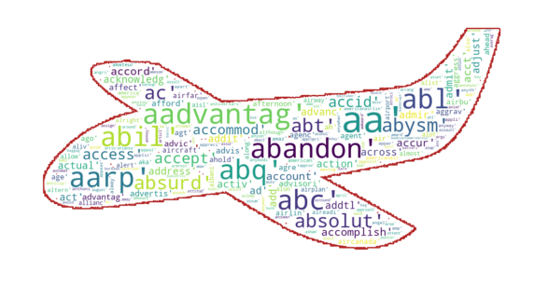
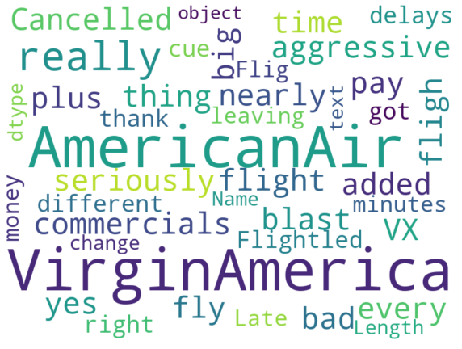
Word Cloud Made of Tokens From Tweets
From text
From Tokenizer's Limited Feature Names

Slide 12
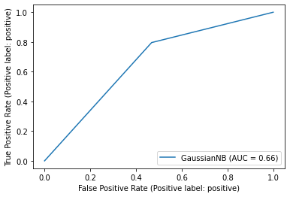
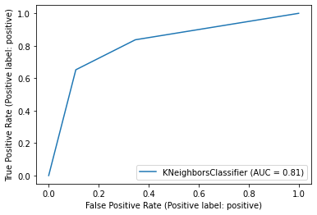
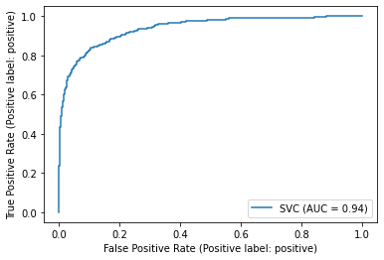
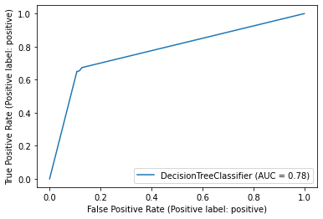
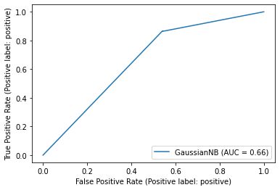

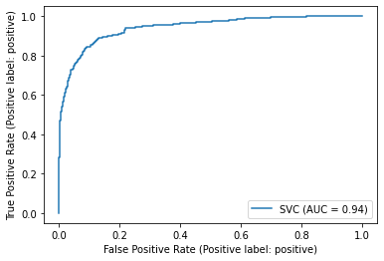
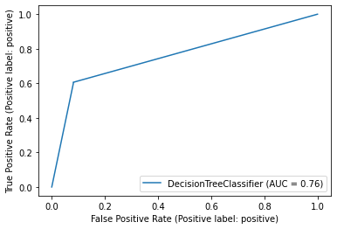
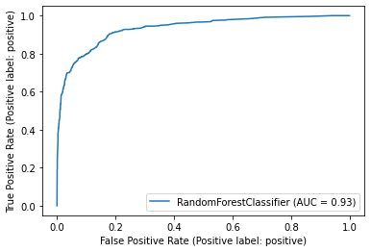
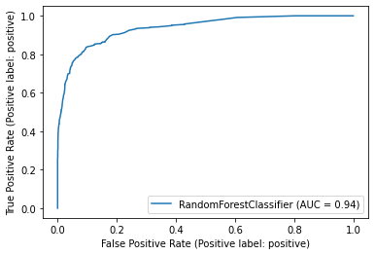
ML Models - TWEETS ROC_AUC Curve Performance
Naïve Bayes Model KNN SVC Decision Tree
Simple Bag of Words
TF – IDF
Random Forest
Simple Bag of Words
SVM and Random Forest model have the very close and have the highest score.
TF – IDF

Slide 13
Machine Leaning Models Performance
SVM best with simple BOW and TF-IDF Accuracy 91% ROC_AUC 94%.
Performance of all models is mostly similar in simple BOW and TF-IDF

Slide 14

Take AWAY
Models are 94% accurate . Sentiment Analysis suggests that tweets are majorly negative. 75% of the tweets of every airlines is negative except Virgin America.
Conduct Fish-Bone analysis with team to establish reasons and target those areas.

Slide 15
Thank you
Group S2 - 2
Alfred George,
Deepa Taneja Chawla,
Nikulkumar Devataja,
Prathap David Carlo,
Rajesh Gandham

